Slide 1
Monday, October 23, 2017
Write In Your Agenda:
Write In Your Monitoring Log:
CW:
Finish and Review Epicenter Location
Earthquakes and Seismic Waves Guided Reading
Earthquakes Study Guide
HW:
Review Earthquake notes for Quiz on Wed. 10/25/17!
Response to Warm-Up:
After Friday’s activity, has your definition of the “Triangle of Uncertainty” changed? Why or why not?
You will need:
Pencil
Agenda
Hand in signed Monitoring Log
Get new Monitoring Log
Epicenter Location Sheet from Friday.

Slide 2
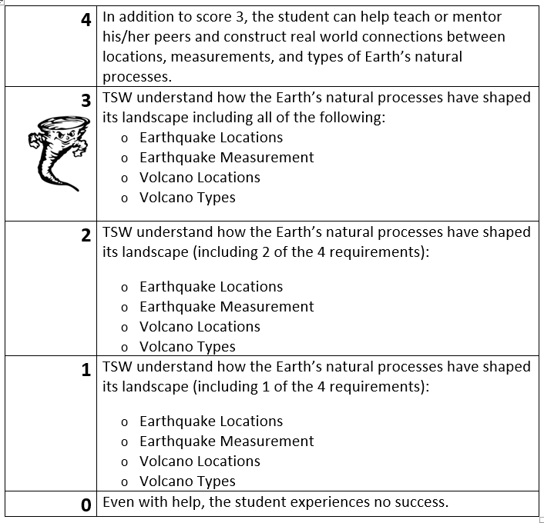
Learning Goal and Scale
TSW understand how the Earth’s natural processes have shaped its landscape (including Earthquake locations and how they are measured as well as Volcano locations and the three types).

